Slide 1
11055 / Programming for Design
14 October 2019 / Semester 2 Week 11
Programming for design
Week 11 – Software Development Lifecycle
Simon Thompson

Slide 2
11055 PfD
14/10/19 – S2W11
Week 9
We looked at the evolution of programming languages through the ‘generations’ of languages.
We looked at the basics of the python language

Slide 3





11055 PfD
14/10/19 – S2W11
Computer Languages
Generations of computer languages have given us many different ways to program.

Slide 4
11055 PfD
14/10/19 – S2W11
Python
Scope is set by spacing
Variables are typed
Only one type of decision statement
def aFunction():
#part of the function
#not part of the function
if this == that:
# do something
elif this <= that:
# do other thing
else:
# do another thing

Slide 5
11055 PfD
14/10/19 – S2W11
Why are we here?
Course Objectives
Identify and critique various programming languages and how they can be utilised within the field of design;
Analyse and apply computer programming techniques through the use of features including loops, variables, functions and objects; and
Create engaging interactive media for different various contexts.

Slide 6
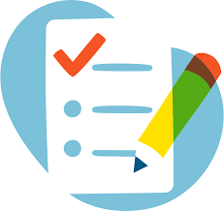


11055 PfD
14/10/19 – S2W11
Quiz
Project 1
Project 2
20% Week 4
Mostly module 1, with maybe a variable question or five
30% Week 7
A JavaScript project using the tools we have learnt
50% Week 13
A Python project using the tools we have learnt

Slide 7
11055 PfD
14/10/19 – S2W11
Project 2 (assignment 3)
Your prototype will read a provided file that contains a list of book isbn numbers. Using python, it will then generate a html page(s) that displays information about the books in a format of your choosing.
Project will include the following:
Flow chart(s) detailing what your program will do.
Set of pseudo-code detailing what how your program will operate.
Python code that will read a file in the correct format, and output the appropriate html/css code that shows information on the books in the file.
To be submitted on GitHub, in the ./Project2/[your student number] directory structure

Slide 8
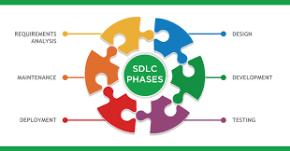
11055 PfD
14/10/19 – S2W11
Software Development Lifecycle
When developing software, generally everyone follows the same process
*There are though many arguments of when you start each piece and if you need to wait for the piece before to be complete or if you are allowed to do the same piece again

Slide 9
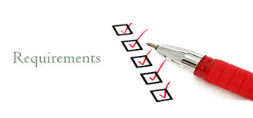
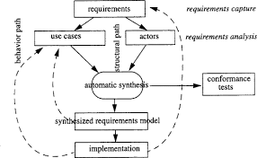
11055 PfD
14/10/19 – S2W11
Requirements Analysis
This is the most important part of any computer program. If this is done badly, it is guaranteed that your program will not be successful.
Understanding what is needed by the actors in the process being programmed is key to programming.
N. Mansurov, D. Zhukov, in SDL '99, 1999

Slide 10
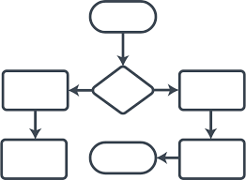
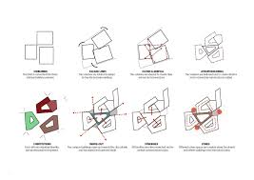
11055 PfD
14/10/19 – S2W11
Design
The design process includes deciding how a particular requirement will be enacted in the system. It also includes deciding what the system will be, in terms of technology and interaction.
You will also design the tests that will ensure that the developers build what you need (requirements).

Slide 11
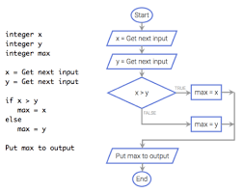
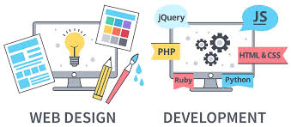
11055 PfD
14/10/19 – S2W11
Development
Once you have designed the solution, now it is time to move from flow charts and drawings to hardware and software.
You will also build the tests during this time.
If your requirements and design phases have been done well, then this stage should be straightforward.

Slide 12
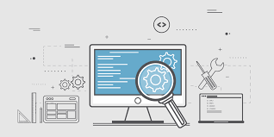
11055 PfD
14/10/19 – S2W11
Testing
The development and testing artefacts will be provided to an independent group (as in not the people who wrote the code) to conduct the testing and ensure that what was built meets the requirements.
Note: unit testing is conducted by the developers in the Development Phase, the testing we are speaking about here is functional, scenario, performance, and lots of other types dependent upon your program.

Slide 13

11055 PfD
14/10/19 – S2W11
Deployment
The deployment phase is when you move your program out for the users.
This comes with various considerations like security, sizing (for infrastructure/databases) and ensuring that there are processes in place if something breaks because of the new things you are releasing.

Slide 14

11055 PfD
14/10/19 – S2W11
Maintenance
This comes with various considerations like security, sizing (for infrastructure/databases) and ensuring that there are processes in place if something breaks.
Are there other programs that are related to yours? What happens if they change or are not available?
You also need to take into account how are you going to support your users?

Slide 15
11055 PfD
14/10/19 – S2W11

Slide 16
11055 PfD
14/10/19 – S2W11
Python

Slide 17
11055 PfD
14/10/19 – S2W11
Decisions – there is only if
if x == 1:
text = “yes”
if x != 1:
text = “no”
else:
text = “yes”
if x == 1:
text = “yes”
elif x == 2:
text = “maybe”
else:
text = “yes”
Short cut:
text = “no” if x == 1 else text = “yes”

Slide 18
11055 PfD
14/10/19 – S2W11
Repetition – Do/loops – there is only while
i = 1;
while i < 10:
text += “The number is” + i
i += 1
i = 1;
while i < 10:
text += “The number is” + i
i += 1
else:
text += “finished the loop”

Slide 19
11055 PfD
14/10/19 – S2W11
Repetition – While - break and continue
i = 1;
while i < 10:
i += 1
if x == 3:
continue
text += “The number is” + i
continue will skip back to the beginning without doing the next steps in the loop
i = 1;
while i < 10:
text += “The number is” + i
if x == 3:
break
i += 1
Break will exit the loop completely

Slide 20
11055 PfD
14/10/19 – S2W11
Repetition – For (has to be used on an array type)
(strings are arrays so this works)
for x in “yourname”:
print(x)
days = [“Mon”, “Tues”, “Wed”]
for x in days:
print(x)
for x in “yourname”:
print(x)
if x == “r”:
break
else:
print(“finished at “ + x)
break, continue and else work just like in the while statement

Slide 21
11055 PfD
14/10/19 – S2W11
Range function
The range function creates a set of numbers for your for statement to use, note that just like all arrays, it starts at 0, therefore
range(6) creates
[0,1,2,3,4,5]
for x in range(6):
print(x)
if x == “4”:
break
else:
print(“finished at “ + x)
range(start_position = 0, max_position, step = 1)

Slide 22
11055 PfD
14/10/19 – S2W11
Files - Open
The open function lets you works with files.
It takes two parameters
Filename & mode
myfile = open(“file.txt”, “rt”)
myfile = open(“file.txt”)
4/8 Modes:
“r” = read only (default)
“a” = opens it so you can add to it. (will create)
“w” = opens it so you can write. (will create)
“x” = creates a file, errors if already exists.
-------------------------------------
“t” = treat as text (default)
“b” = treat as binary (images)

Slide 23
11055 PfD
14/10/19 – S2W11
Files - Read
The read function lets you read files.
It will return the entire file
print (myfile.read())
Or characters
print (myfile.read(10))
Will print only the first 10 characters of the file.

Slide 24
11055 PfD
14/10/19 – S2W11
Files – Read a line
The readline function lets you read lines from a file.
It will return the entire line
print (myfile.readline())
You can use the for statement to read each line in a file:
for xlines in myfile:
print(xlines)

Slide 25
11055 PfD
14/10/19 – S2W11
Files - Write
The write function lets you write information to the file.
If you opened in “a” mode (append) it will write to the end of the file.
If you opened in “w” mode (write) it will overwrite the current file.
myfile.write(“Writing to the file)

Slide 26
11055 PfD
14/10/19 – S2W11
Files - Close
The close function lets you close files you are finished using.
myfile.close()

Slide 27
Exercise 1
11055 PfD
14/10/19 – S2W11
Can you now create your traffic light in python?

Slide 28
Exercise 2
11055 PfD
14/10/19 – S2W11
Create a text file called one.txt and put in it the names of three of your family or friends.
Write a python program that reads that file, prints the names on the screen and writes a new file called two.txt with the names in the opposite order.

Slide 29
Exercise 3
11055 PfD
14/10/19 – S2W11
Write a python program that creates a new html file with the basic html, head and body tags and a heading in the body saying “Hello World”.

Slide 30
Project
11055 PfD
14/10/19 – S2W11
Any questions?

